Slide 1
A Unified Multimodal De- and Re-coupling Framework for RGB-D Motion Recognition
Name: Sameer Sadman Chowdhury
ID: 23341118

Slide 2
Introduction and Purpose
Motion Recognition
RGB-D
Video Augmentation
Complement Feature
Late Fusion

Slide 3
Contribution and Related Work
Video Data Augmentation
Motion Recognition based on RGB-D Data

Slide 4

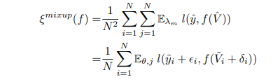
Methodology
Spatiotemporal Regularization

Slide 5
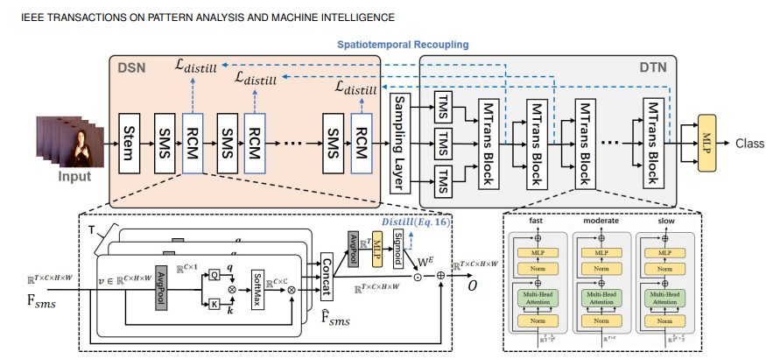
Fig: The unimodal representation learning network

Slide 6
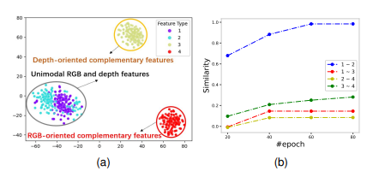
Decoupling and Recoupling Learning

Slide 7
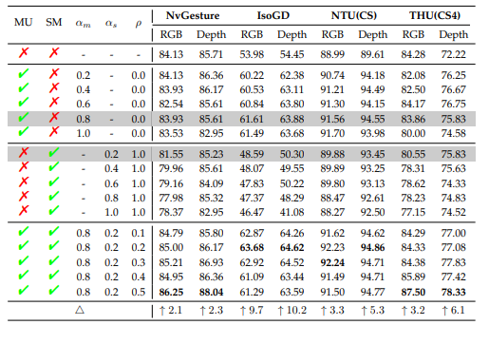
Cross-modal Complement Features Learning

Slide 8
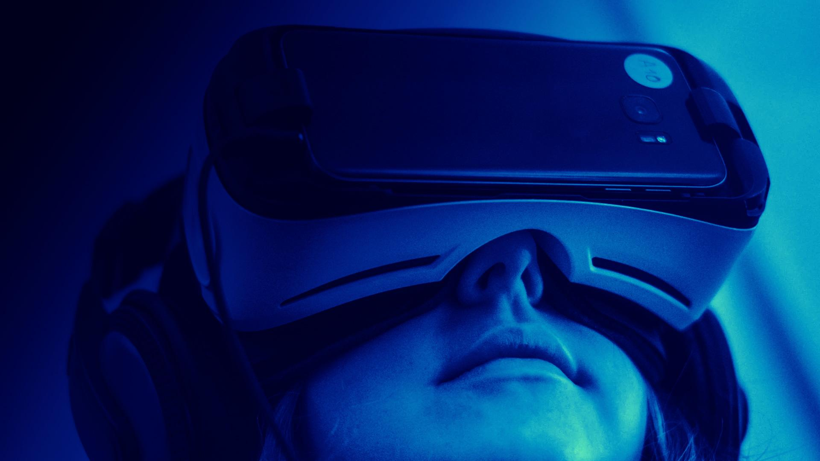
Limitations
Restricted to only isolated motion recognition
Method explored only on RGB modalities

Slide 9
Future Work
Extension of proposed framework
Incorporate more advanced techniques

Slide 10
Thank You

